Slide 1

In-Flight WhatsApp Tunneller
Matthew Mittelsteadt​
Michael Lum​
Shirley Xiaolin Xu​
Soren Netka​
Spencer Yost​

Slide 2

Goal
Browse the internet during a flight without paying for WiFi access.
How
Gain limited internet access on a flight that offers free in-flight messaging.
Smuggle requests and responses past the Firewall using WhatsApp messenger (a.k.a. tunnelling).

Slide 3
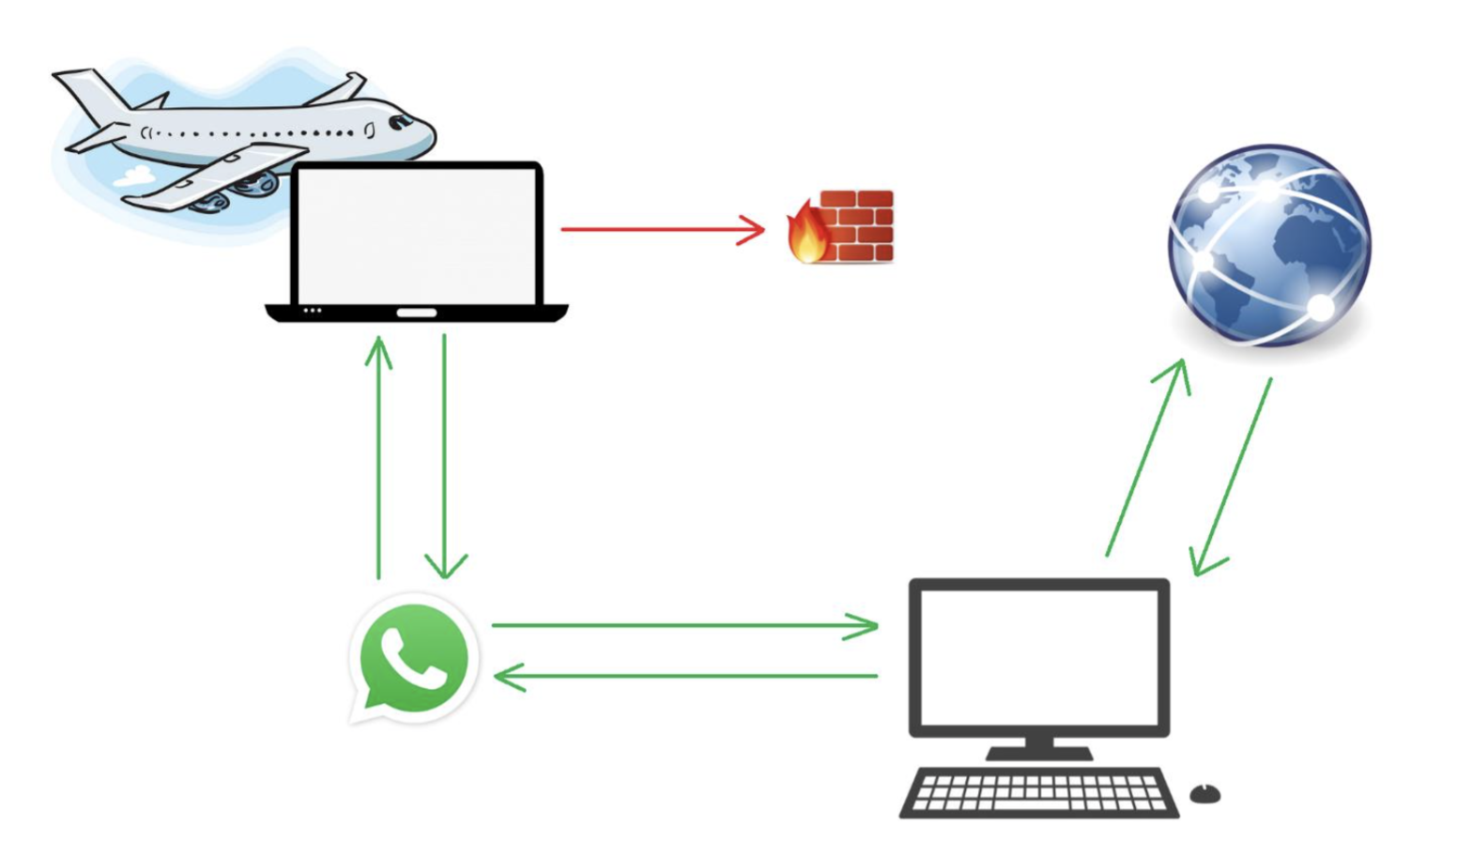
Web requests from browsers blocked!
Client
Our project: Tunnel through WhatsApp to surreptitiously get full Internet browsing
Server

Slide 4

Host A(“client”)
WhatsApp message sent to instance running on server.
Browser(with local proxy set up in settings)
Python Proxy
WhatsApp
Returning WhatsApp message from instance running on server.
Pyautogui magic

Slide 5
Host B (“server”)
Http(s) request to the internet
WhatsApp message from client
WhatsApp – Copy 2
Python Tunneller
Squid Proxy
WhatsApp message returned to client
Http(s) response from the internet
Pyautogui magic

Slide 6
Host A (client)

Slide 7
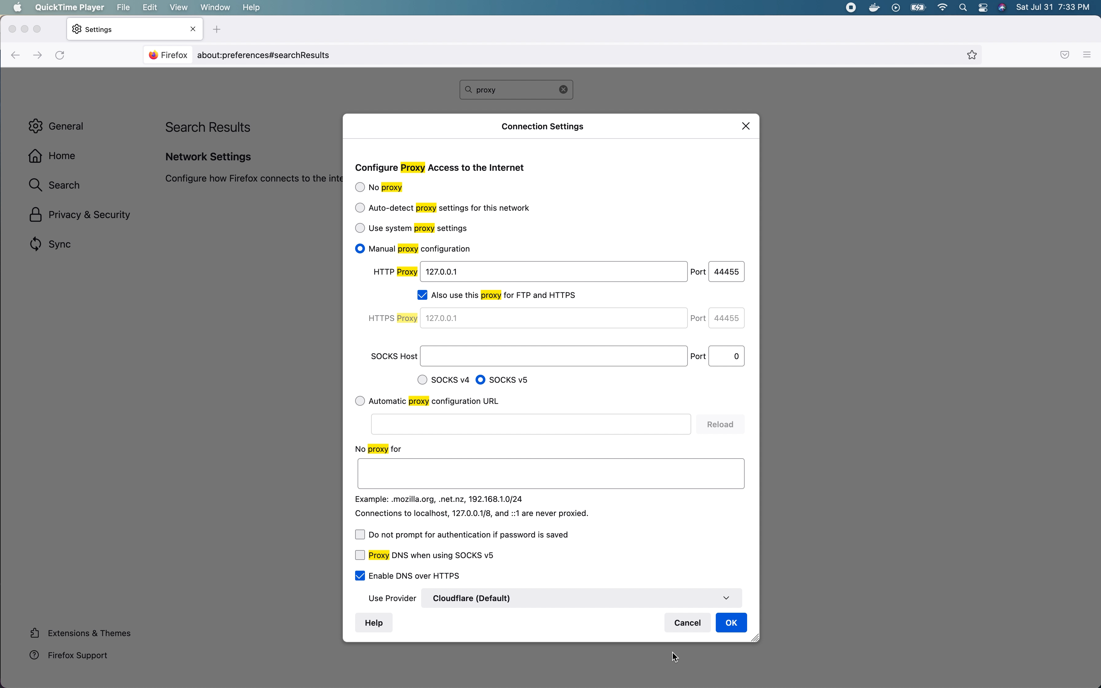
Click to add caption
P A R T 0 1

Slide 8
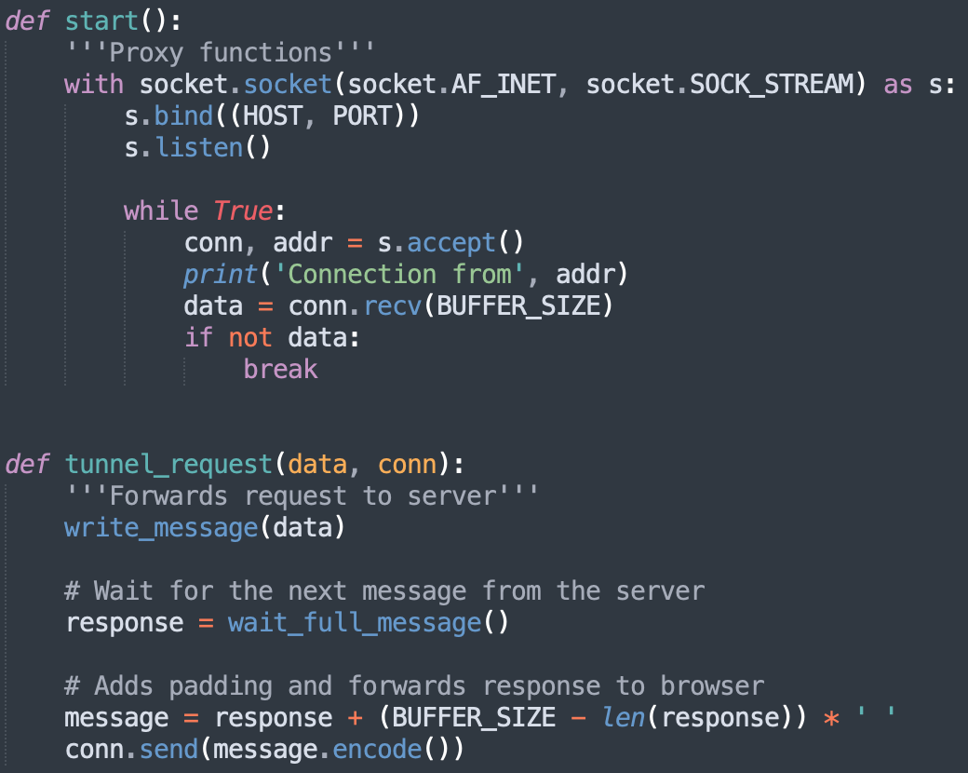
Even though this is the client-side of the WhatsApp proxy, it is the server side of the browser proxy.

Slide 9
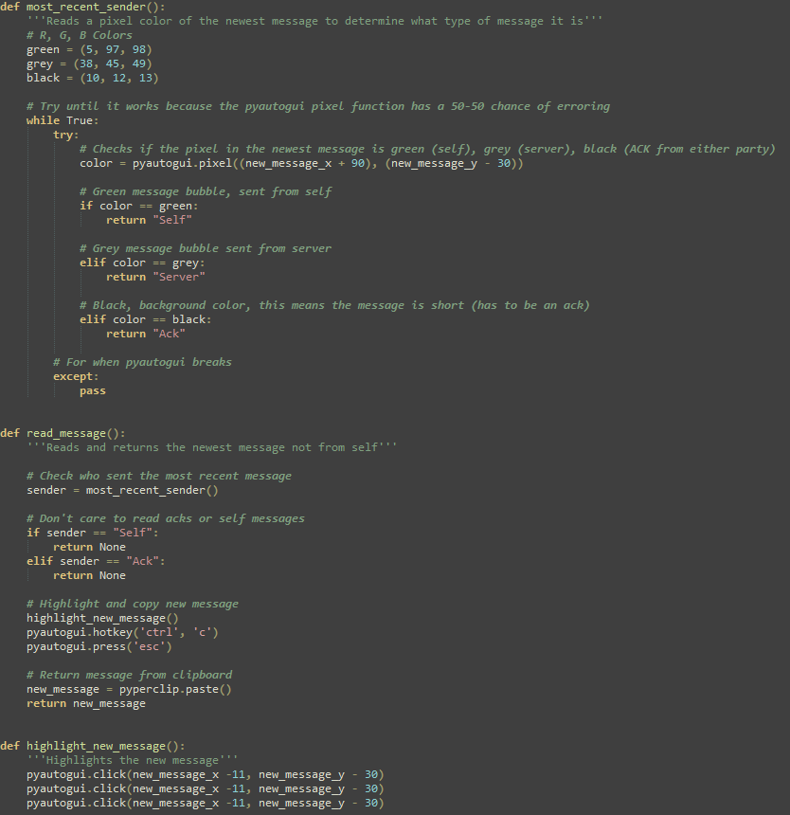
Reading Messages from the GUI
Polling for new messages
Checking pixel color to determine sender
Triple clicking on message bubbles to highlight and copy text

Slide 10
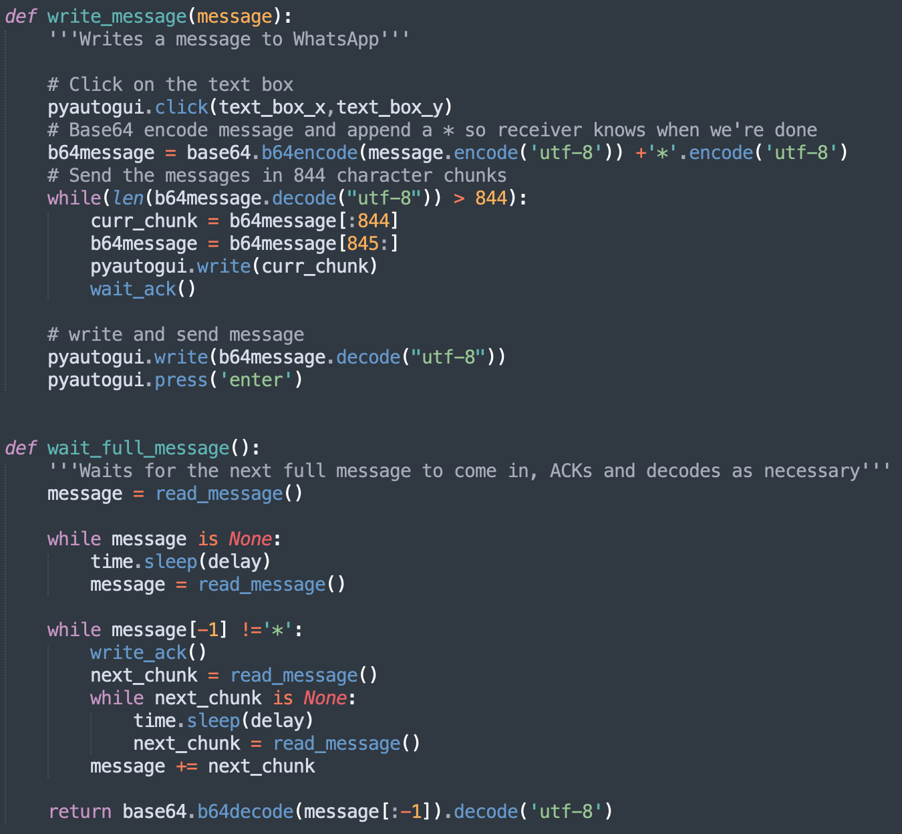
WhatsApp messages display up to 844 characters. We write and send requests in chunks, and stitch WhatsApp messages together for a full response.

Slide 11
Challenge: Tunnel not forwarding responses to browser until connection closes Solution: Padding Missing: - Error handling - Logging - Multithreading

Slide 12
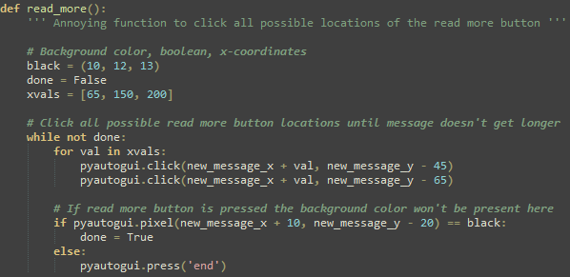
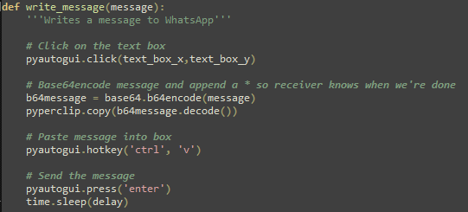
A Faster Way of Doing Things
No more chunking messages, no acks
Shorter helper functions
Pyperclip.paste instead of pyautogui.write

Slide 13
Host B (server) and Squid

Slide 14
Host B (server)
Machine and Services
Software and Tools
VirtualBox based virtual machine
8GB RAM
Ubuntu 20.04 (Focal Fosse)
Squid Proxy (systemctl service control)
Gnome desktop
Shared drive with host
Forwarded ports between host and VM
WhatsApp
Pyautogui and dependencies
Python3
Packaged and distributed to team members with Vagrant

Slide 15


Host B Provisioning
Vagrant Cloud
Download a “base” copy of your preferred OS
Configure Base OS (install Desktop, configure, etc.)
Install and configure Squid Proxy server
Install/Upgrade Python to the version you want
Install PyAutoGUI and dependencies
Package using Vagrant and upload to Vagrant Cloud

Slide 16

Proxies
P A R T 0 1
We used two proxies – One at the client and one at the server.
The proxy at the server is a full-featured proxy server to simplify handling web requests from the browser (which thinks it’s talking to a proxy), simplify responses, understands CDN and other difficult to navigate redirects, and simplify content delivery to our tunneller apps.
We decided on Squid because it is open source, supports authentication, is a full caching proxy server, and widely used and understood.

Slide 17
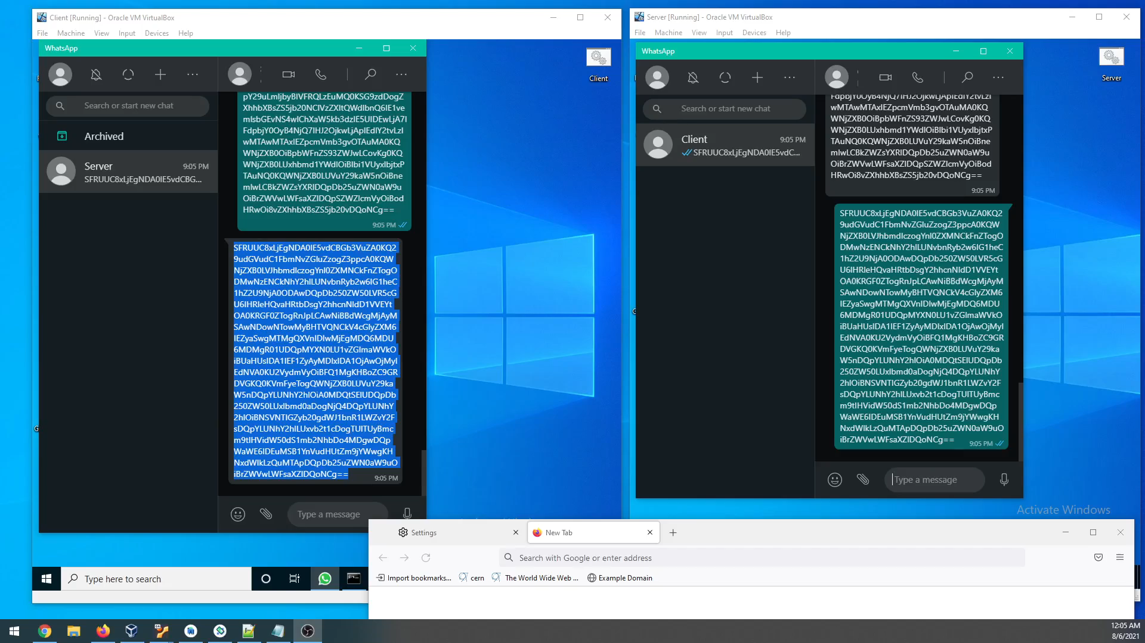

Slide 18


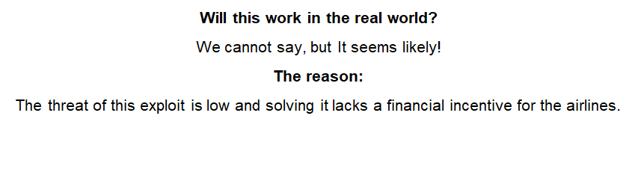
P A R T 0 1

